Slide 1

Note: The data and information in this document is reflective of a hypothetical situation and client. This document is to be used for KPMG Virtual Internship purposes only.
Sprocket Central Pty Ltd
Data analytics approach
[Division Name] - [Engagement Manager], [Senior Consultant], [Junior Consultant]

Slide 2
Note: The data and information in this document is reflective of a hypothetical situation and client. This document is to be used for KPMG Virtual Internship purposes only.
Agenda
Introduction
Data Exploration
Model Development
Interpretation

Slide 3
Note: The data and information in this document is reflective of a hypothetical situation and client. This document is to be used for KPMG Virtual Internship purposes only.
Introduction
Customer Analysis
Age distribution
Number of bike purchases in 3 years
Job industry category
Wealth Segments
Number of cars own on each states

Slide 4
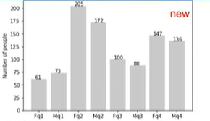
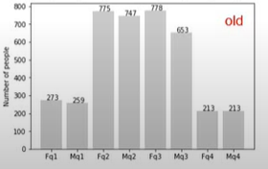
Note: The data and information in this document is reflective of a hypothetical situation and client. This document is to be used for KPMG Virtual Internship purposes only.
Data Exploration
Customers’ Age Distribution
Through this visual representation we can analyze that mostly new customers are between the age of 25 – 48 years old.
Customers between 48-59 age group have drastically dropped.
Slight increase in customers above 59 years of age in percentages.
Below 25 years of age has not really changed.

Slide 5
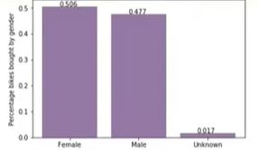
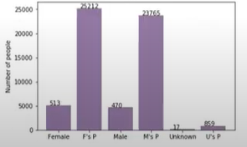
Note: The data and information in this document is reflective of a hypothetical situation and client. This document is to be used for KPMG Virtual Internship purposes only.
Model Development
Bike purchase in last 3 years
As we can see new customers are females with 50.6% purchase with total of 25,216 bikes.
Male contributed to 47.7% purchases with 23,765 bikes
So we should focus on advertising on female customers than male customers.

Slide 6
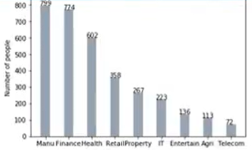
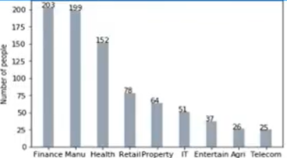
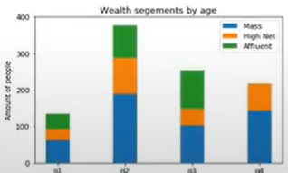
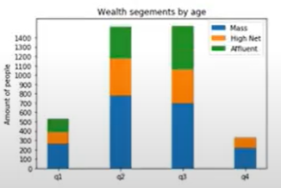
Note: The data and information in this document is reflective of a hypothetical situation and client. This document is to be used for KPMG Virtual Internship purposes only.
Interpretation
Job Industry Category
Mostly our new customers are on Finance Industry and our manufacturing are in top 2.
Rest industries are same.
Wealth Segment
In all ages, the numbers of mass customers is the highest so we should focus on this social class.
After that we should focus on high net customers.
Then affluent customers but mostly second and third quadrant.

Slide 7
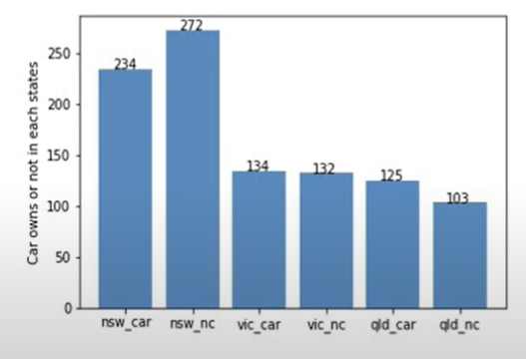
Number of cars owned
Note: The data and information in this document is reflective of a hypothetical situation and client. This document is to be used for KPMG Virtual Internship purposes only.
Interpretation
NSW should be considered the most since numbers of customers don’t own cars is significantly larger than that own.
VIC and QLD has more customers that own car that who don’t but we can try to have something so that those owns car will buy bikes.

Slide 8
Note: The data and information in this document is reflective of a hypothetical situation and client. This document is to be used for KPMG Virtual Internship purposes only.
Appendix

Slide 9
Note: The data and information in this document is reflective of a hypothetical situation and client. This document is to be used for KPMG Virtual Internship purposes only.
Appendix
This is an optional slide where you may place any supporting items.

